Slide 1
MODULE_2 ALU

Slide 2
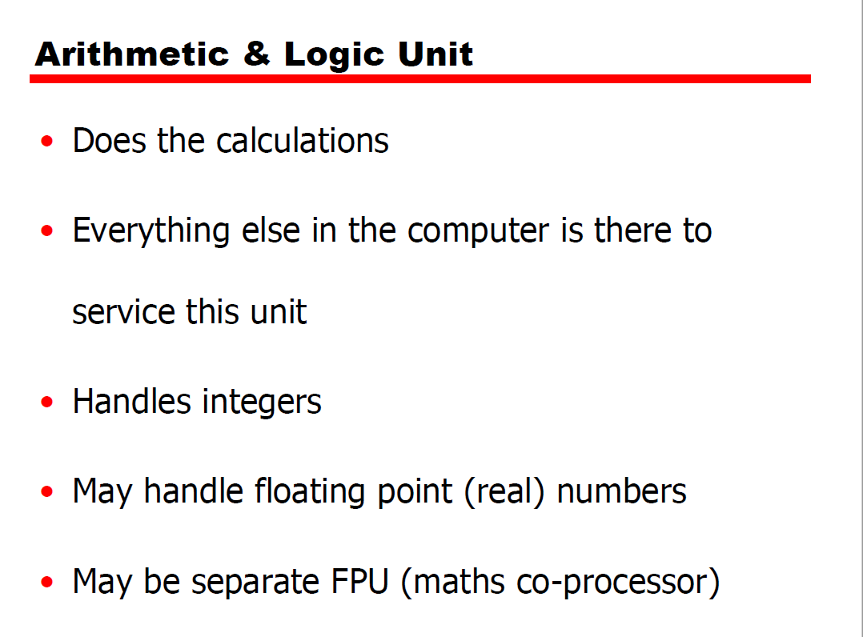

Slide 3
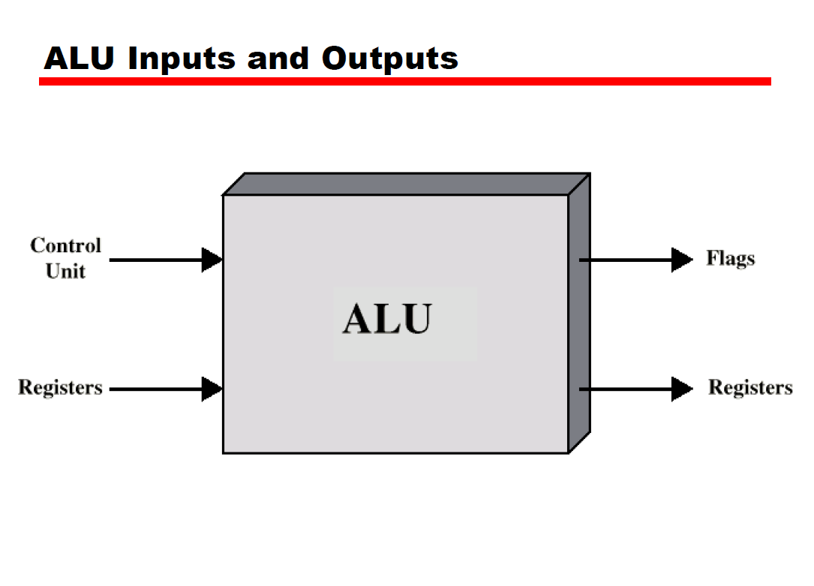

Slide 4
Computer Arithmetic
Computer arithmetic is commonly performed on two very different types of numbers: integer and floating point.

Slide 5
FIXED and FLOATING POINT NUMBERS
There are two major approaches to store real numbers (i.e., numbers with fractional component) .
These are
(i) Fixed Point Notation and
(ii) Floating Point Notation.

Slide 6
Fixed point Notation
In fixed point notation, there are a fixed number of digits after the decimal point.
Whereas
floating point number allows for a varying number of digits after the decimal point.

Slide 7
Integer Representation
For purposes of computer storage and processing, we do not have the minus sign.
Only binary digits (0 and 1) may be used to represent numbers(Signed & Unsigned).
2’s complement representation is used for signed numbers.

Slide 8
Signed Integers Representation
2’s Complement Representation
Twos complement representation uses the most significant bit as a sign bit, making it easy to test whether an integer is positive or negative.
The range of 2’s complement numbers is from -2 power (n-1) to 2power(n-1) - 1.

Slide 9
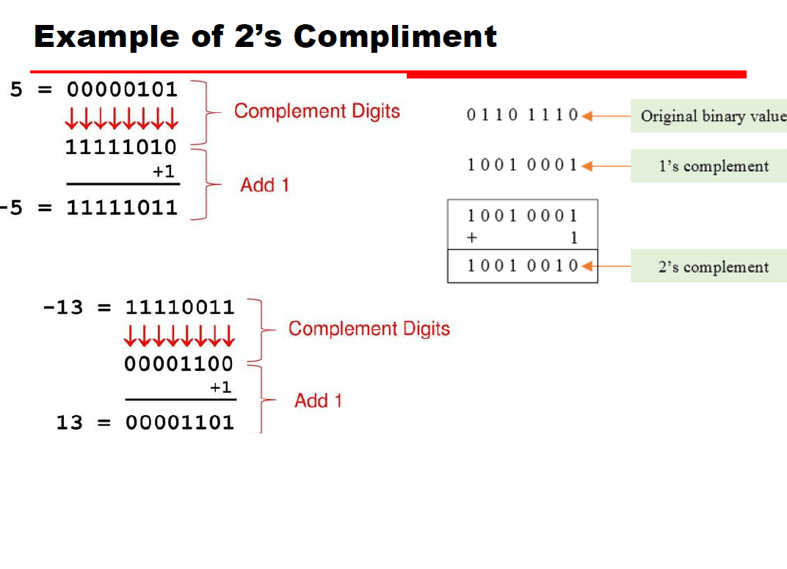

Slide 10
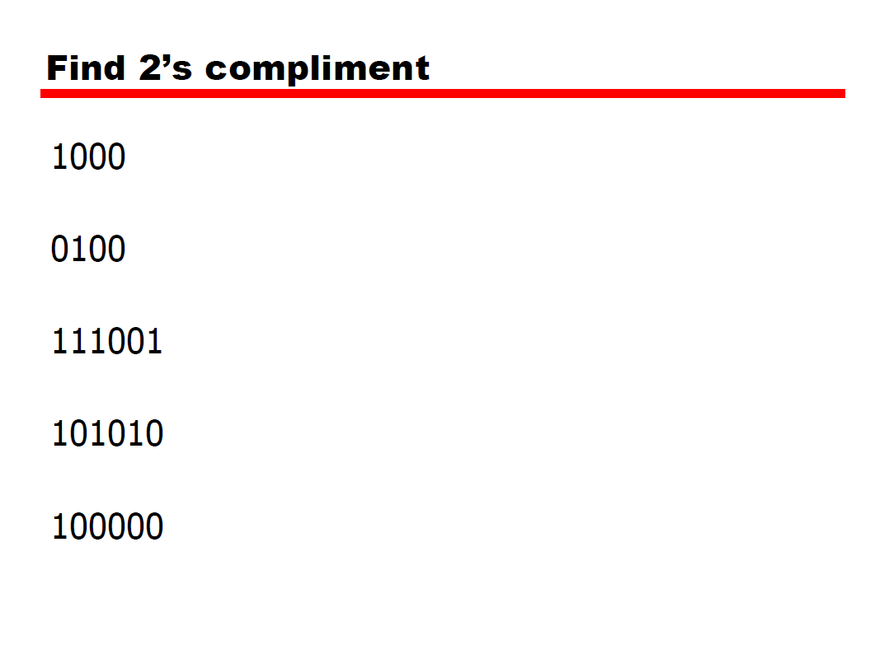

Slide 11
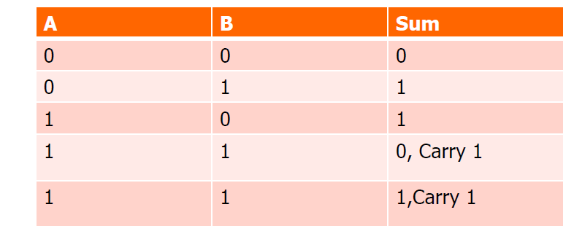
Binary Addition

Slide 12
Integer Arithmetic
Addition and Subtraction(Addition in twos complement)
Addition proceeds as if the two numbers were unsigned integers .
If the result of the operation is positive(sign bit 0), we get a positive number in twos complement form, which is the same as in unsigned-integer form.

Slide 13
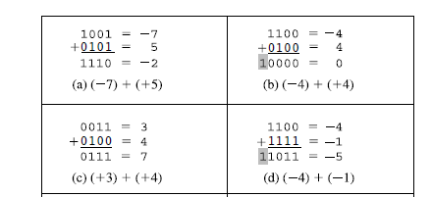
Addition in twos complement
Operation is negative(sign bit 1), we get a negative number in twos complement form.
In some instances, there is a carry bit beyond the end of the word , which is ignored.

Slide 14
Overflow in Addition
On any addition, the result may be larger than can be held in the word size being used .
This condition is called overflow.

Slide 15

Addition in twos complement
OVERFLOW RULE: If two numbers are added, and they are both positive or both negative, then overflow occurs if and only if the result has the opposite sign.
Eg:-

Slide 16
2’s Complement Subtraction
SUBTRACTION RULE: To subtract one number (subtrahend) from another (minuend), take the twos complement (negation) of the subtrahend and add it to the minuend.

Slide 17
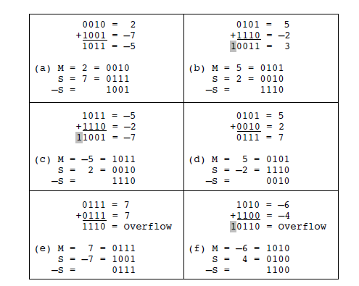

Slide 18
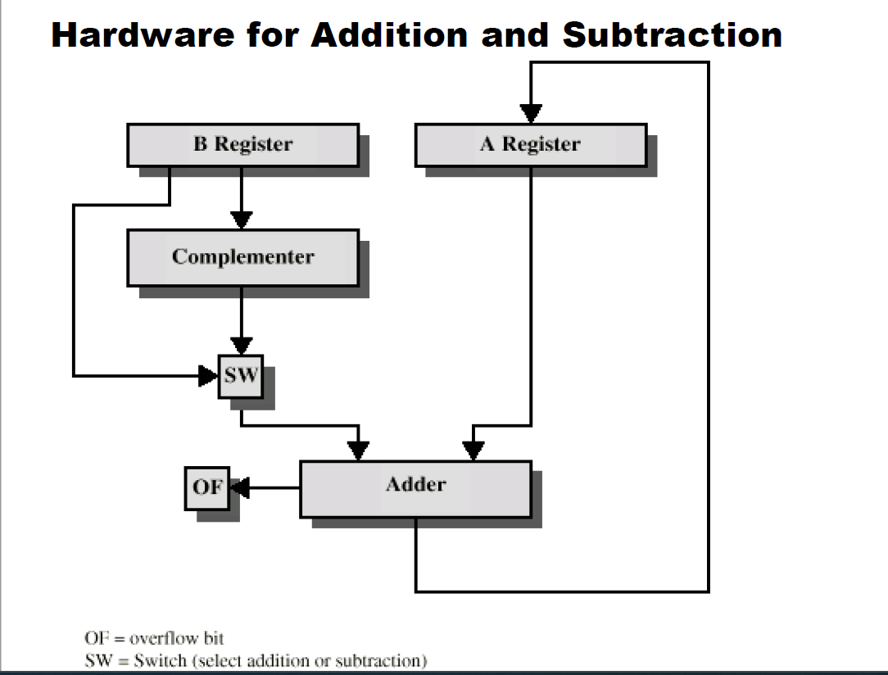

Slide 19
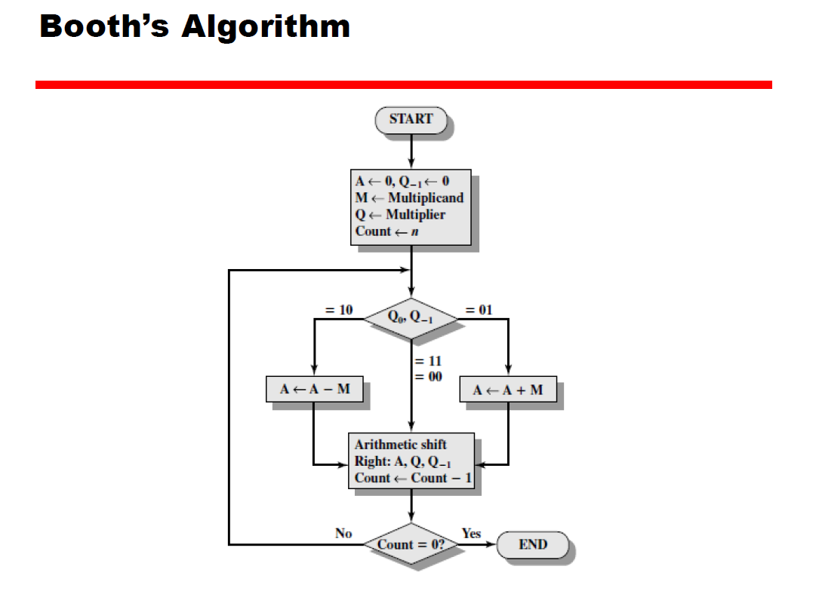

Slide 20
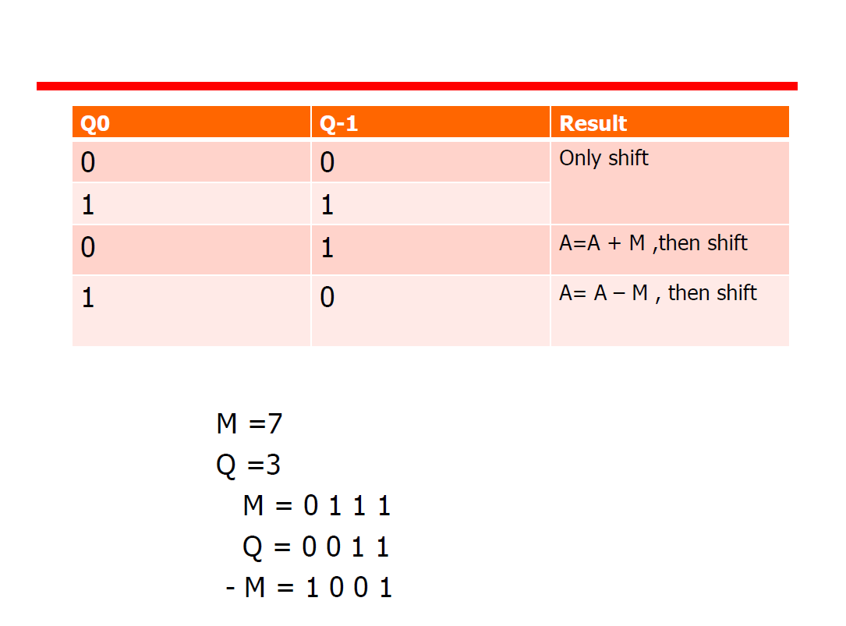

Slide 21
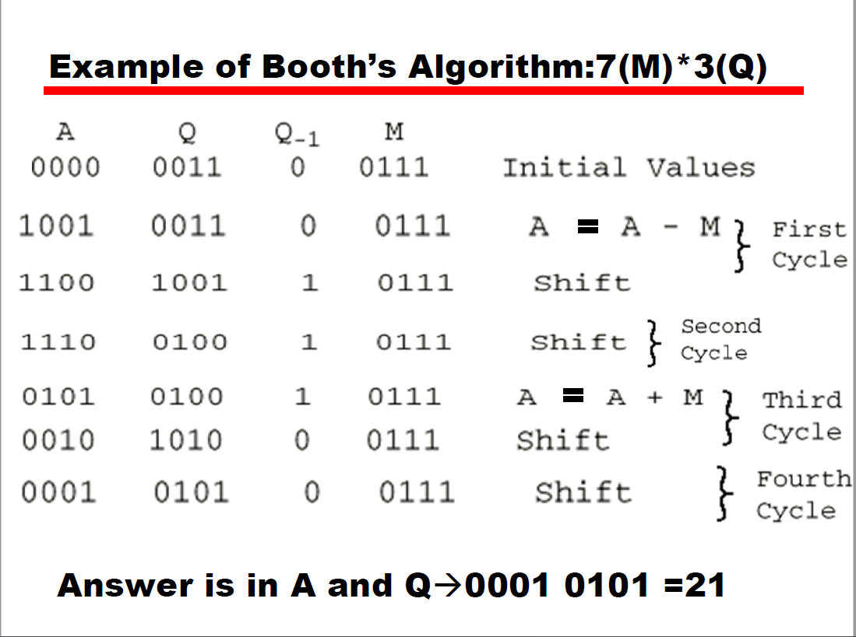

Slide 22
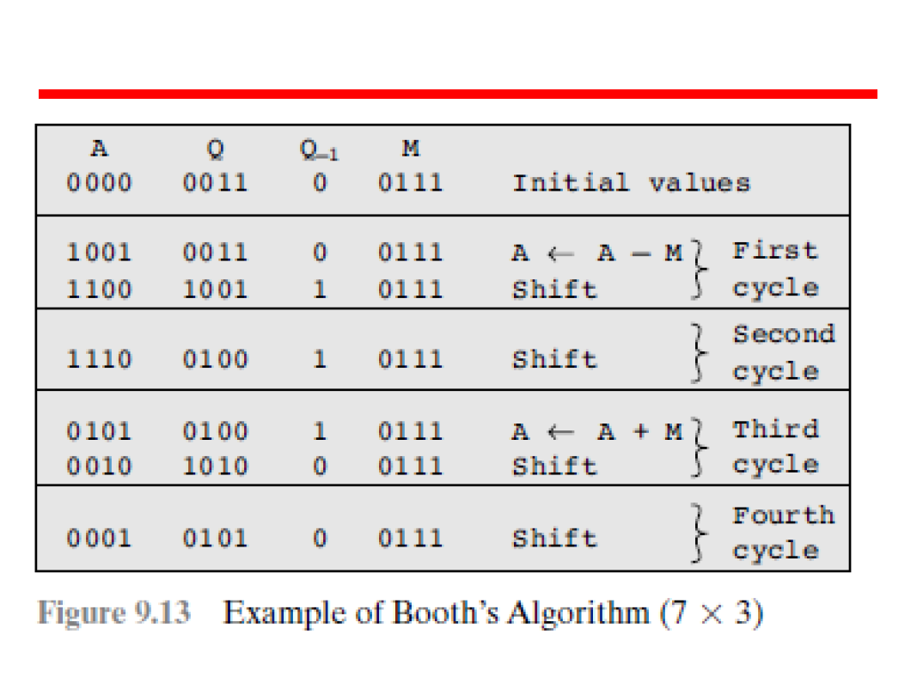

Slide 23
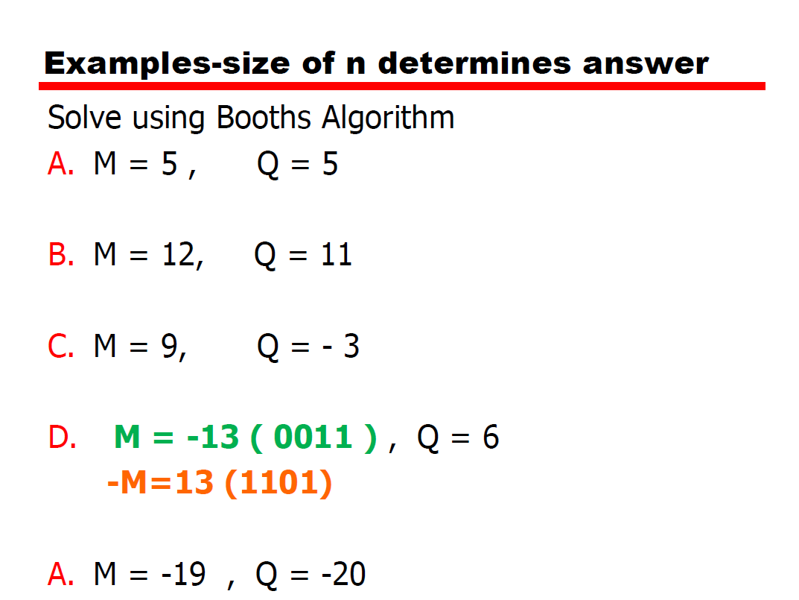

Slide 24
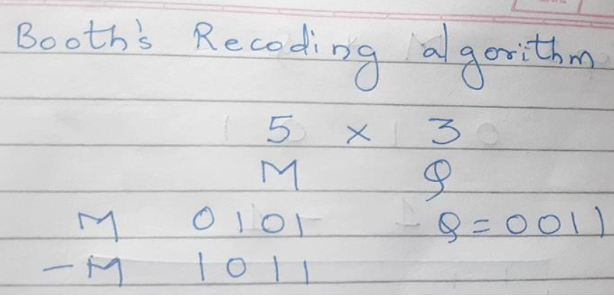
Booths Recoding Algorithm

Slide 25
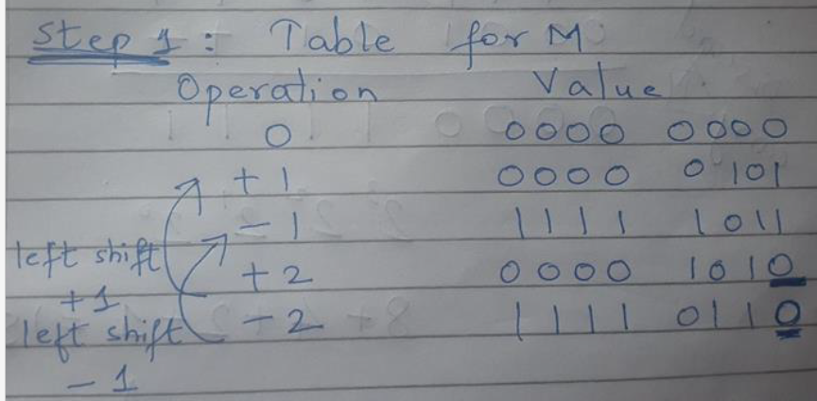

Slide 26
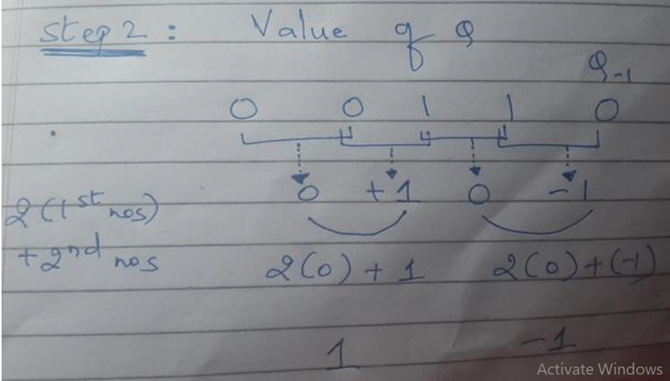

Slide 27
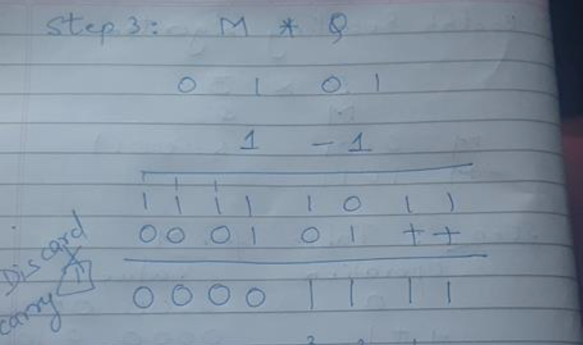

Slide 28
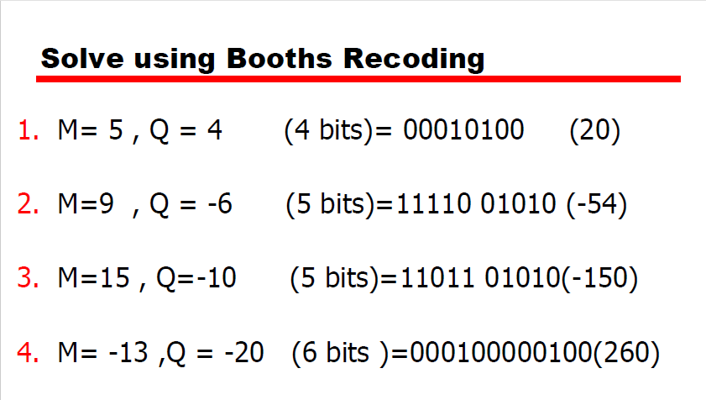

Slide 29
Division
Division is somewhat more complex than multiplication.
First, the bits of the dividend are examined from left to right, until the set of bits examined represents a number greater than or equal to the divisor.
This is referred to as the divisor being able to divide the number.

Slide 30
Division
Until this event occurs, 0s are placed in the quotient from left to right.
When the event of divisibility occurs, a 1 is placed in the quotient and the divisor is subtracted from the partial dividend.
The result is referred to as a partial remainder.

Slide 31
Division
From this point on the division follows a cyclic pattern.
At each cycle, additional bits from the dividend are appended to the partial remainder until the result is greater than or equal to the divisor.
As before, the divisor is subtracted from this number to produce a new partial remainder.
The process continues until all the bits of the dividend are exhausted.

Slide 32
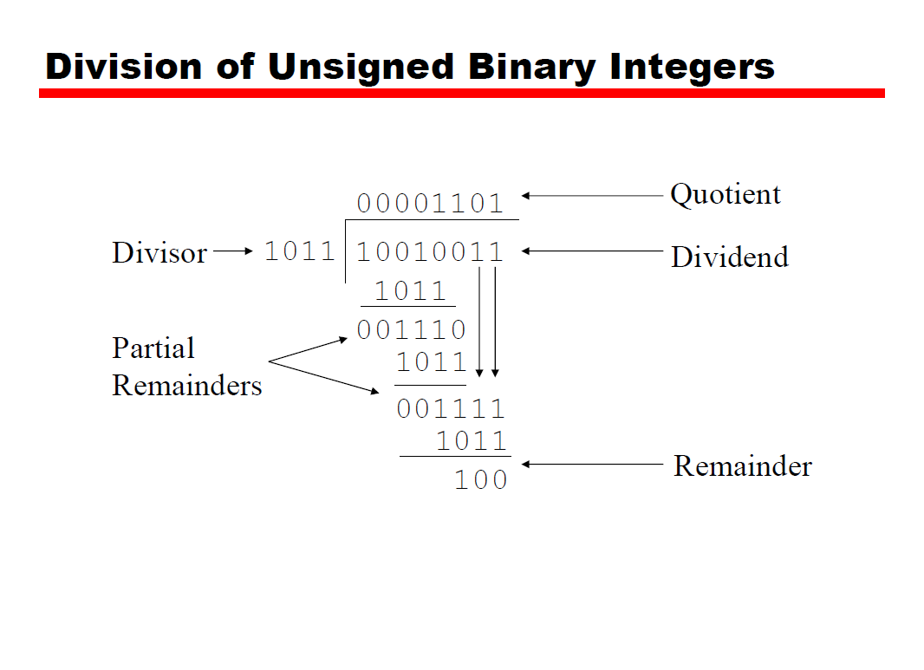

Slide 33
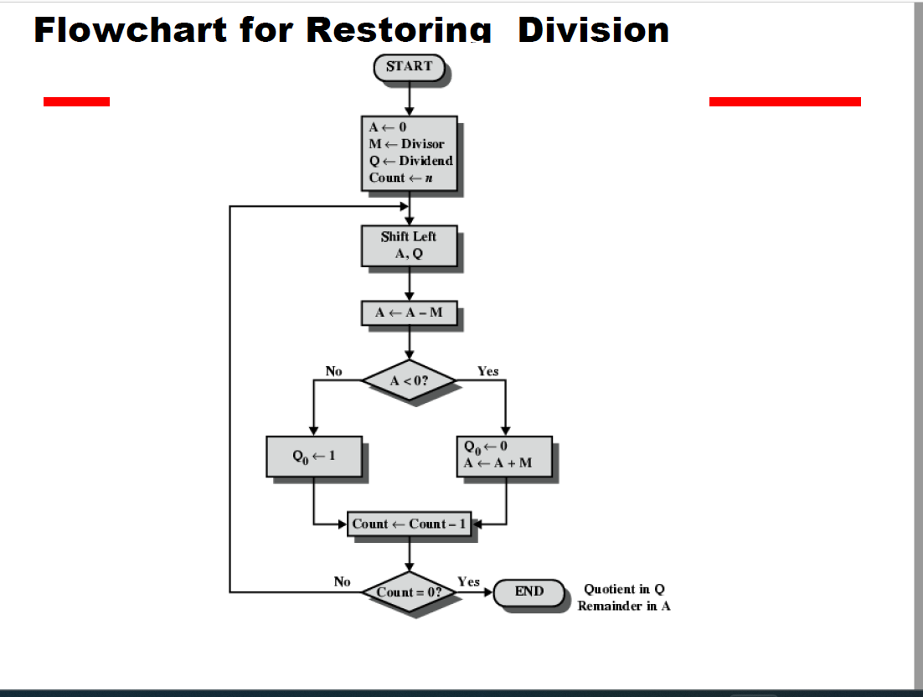

Slide 34
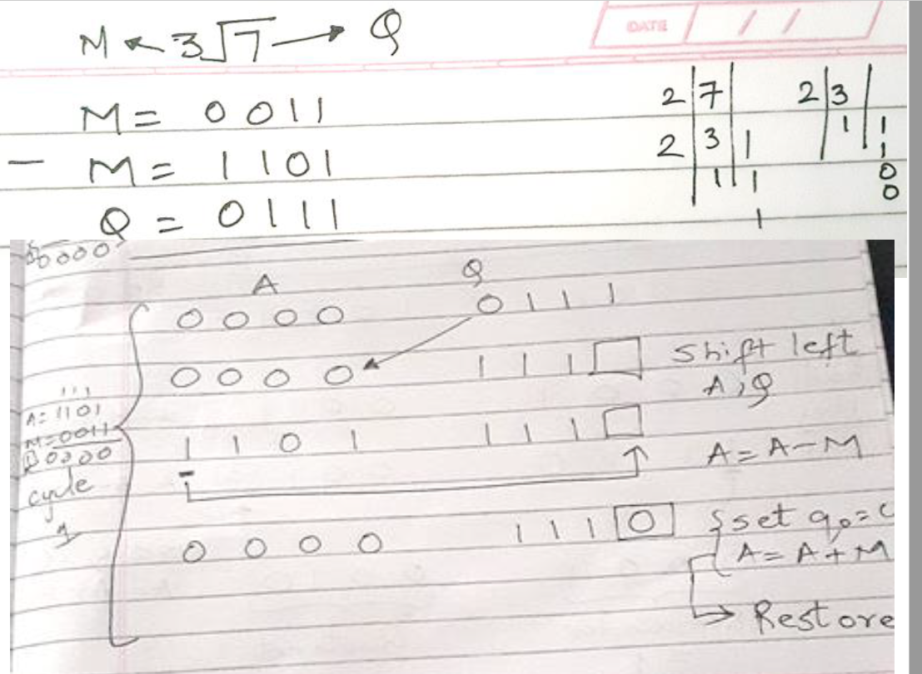

Slide 35
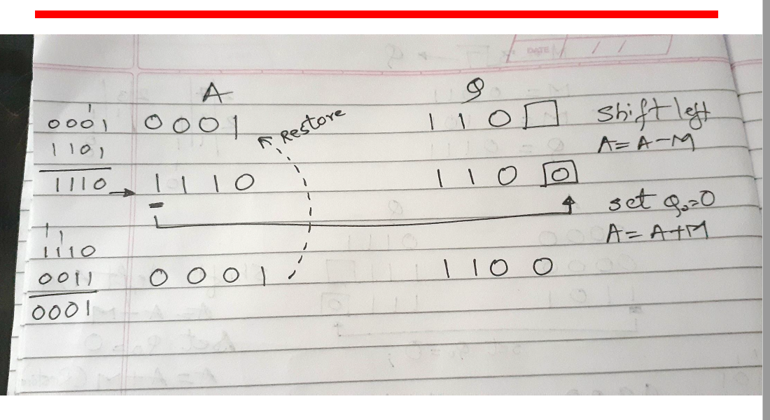

Slide 36
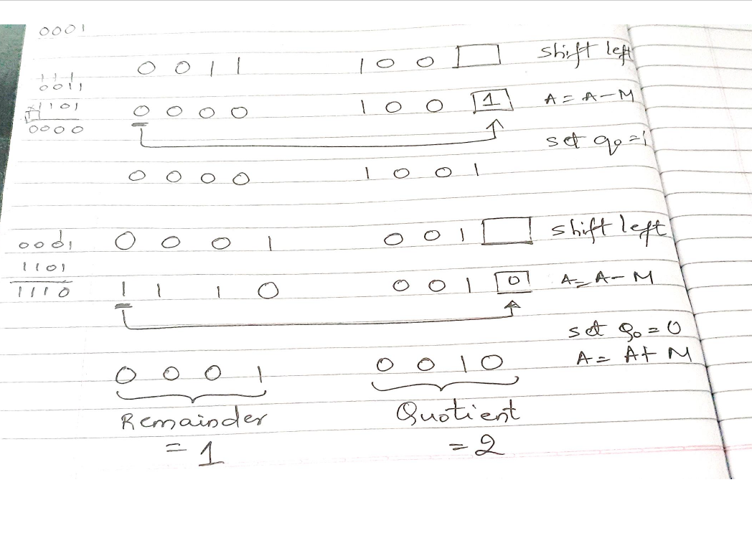

Slide 37
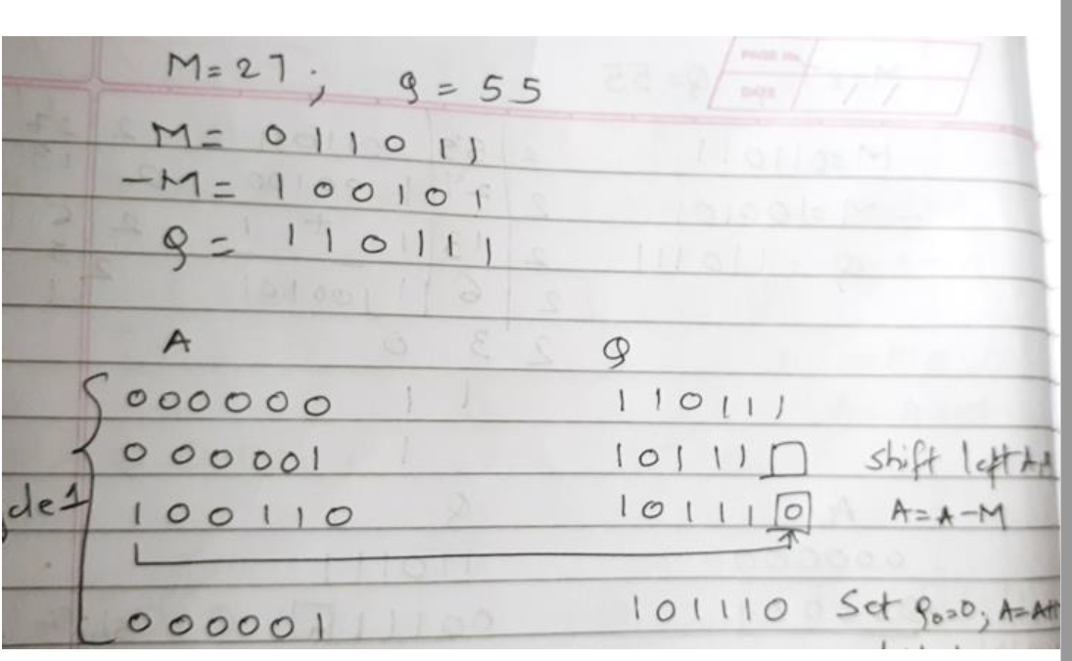

Slide 38
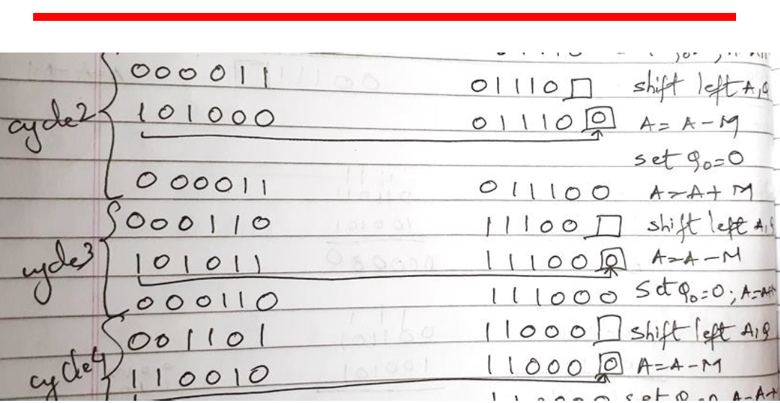

Slide 39
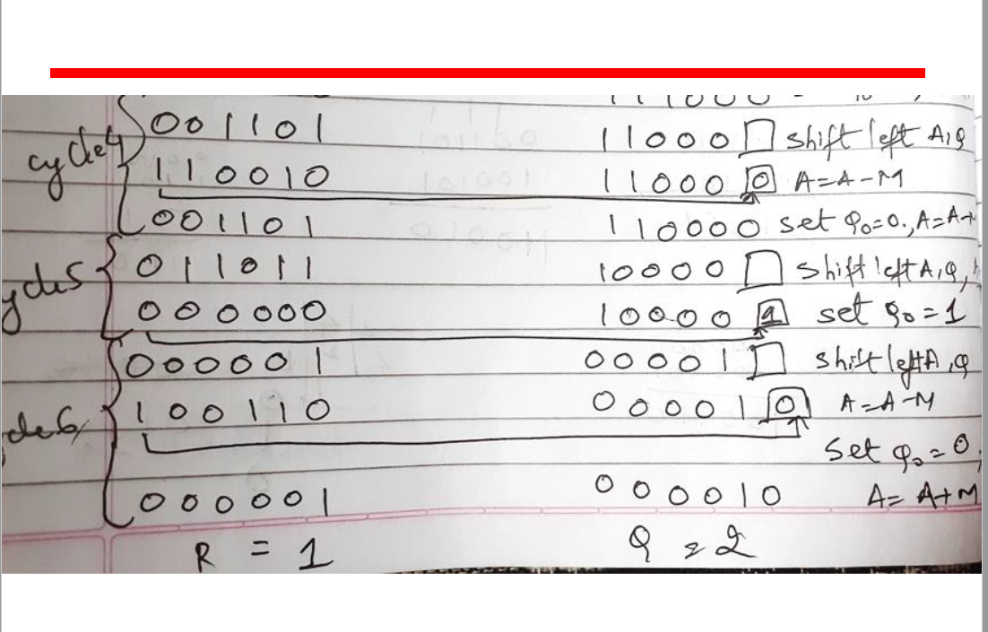

Slide 40
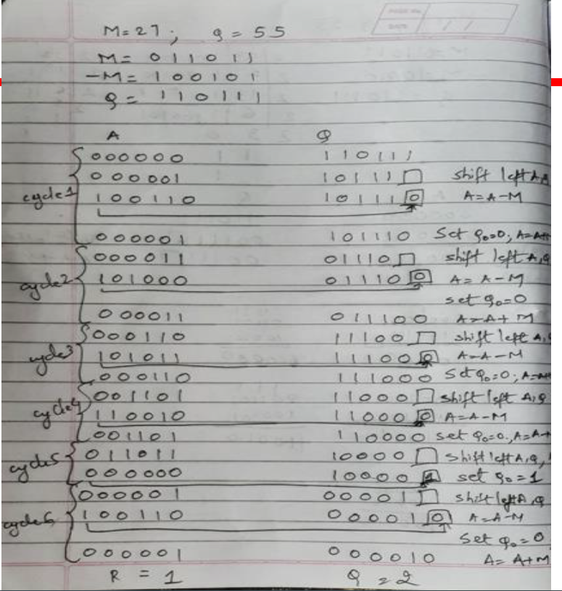

Slide 41
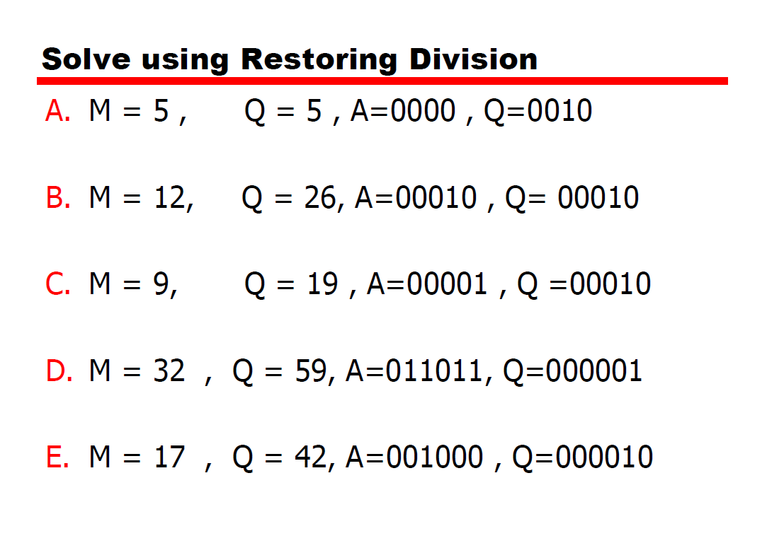

Slide 42
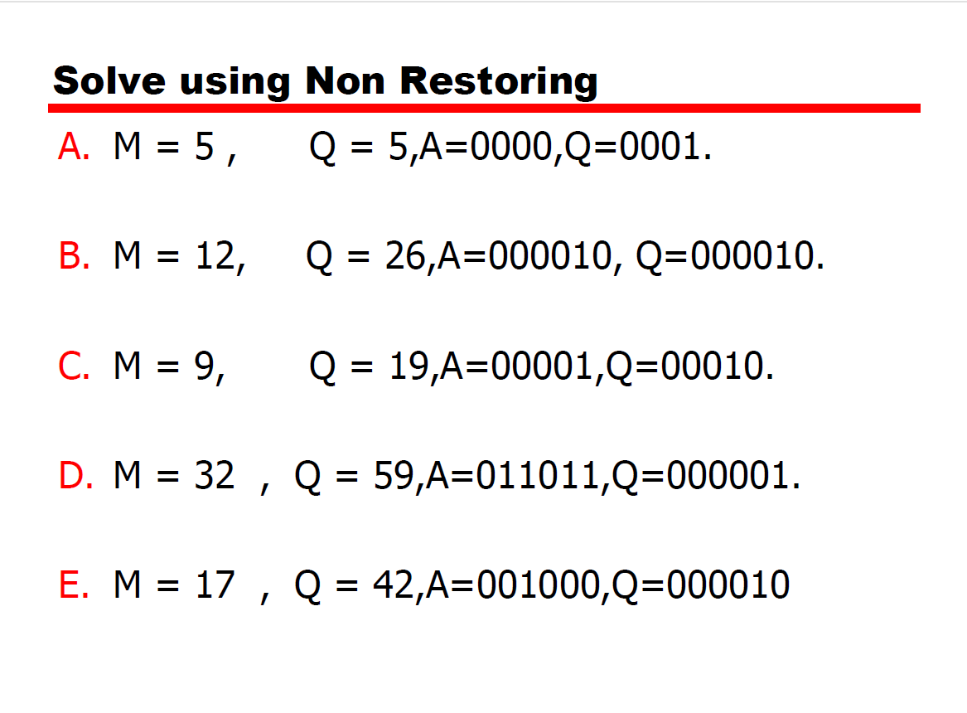

Slide 43
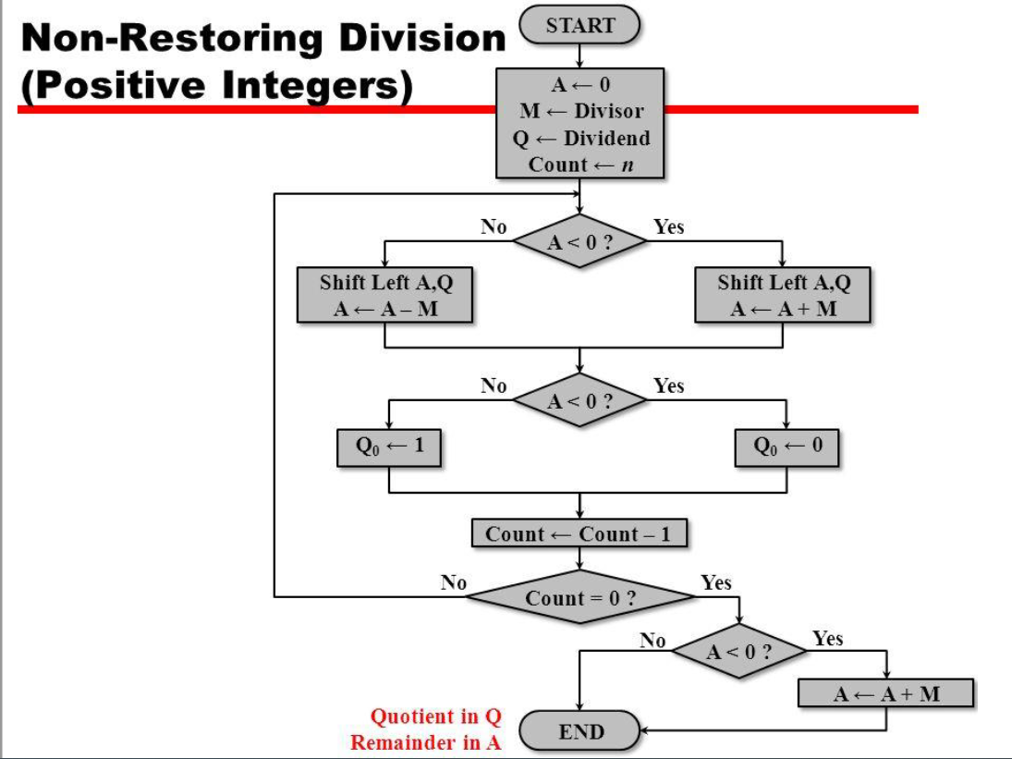

Slide 44
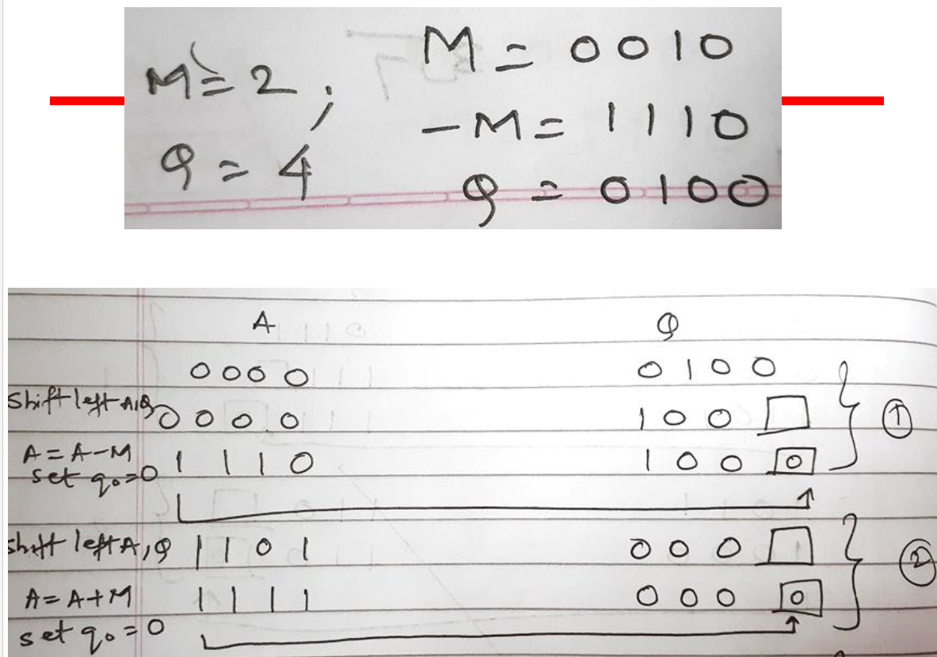

Slide 45
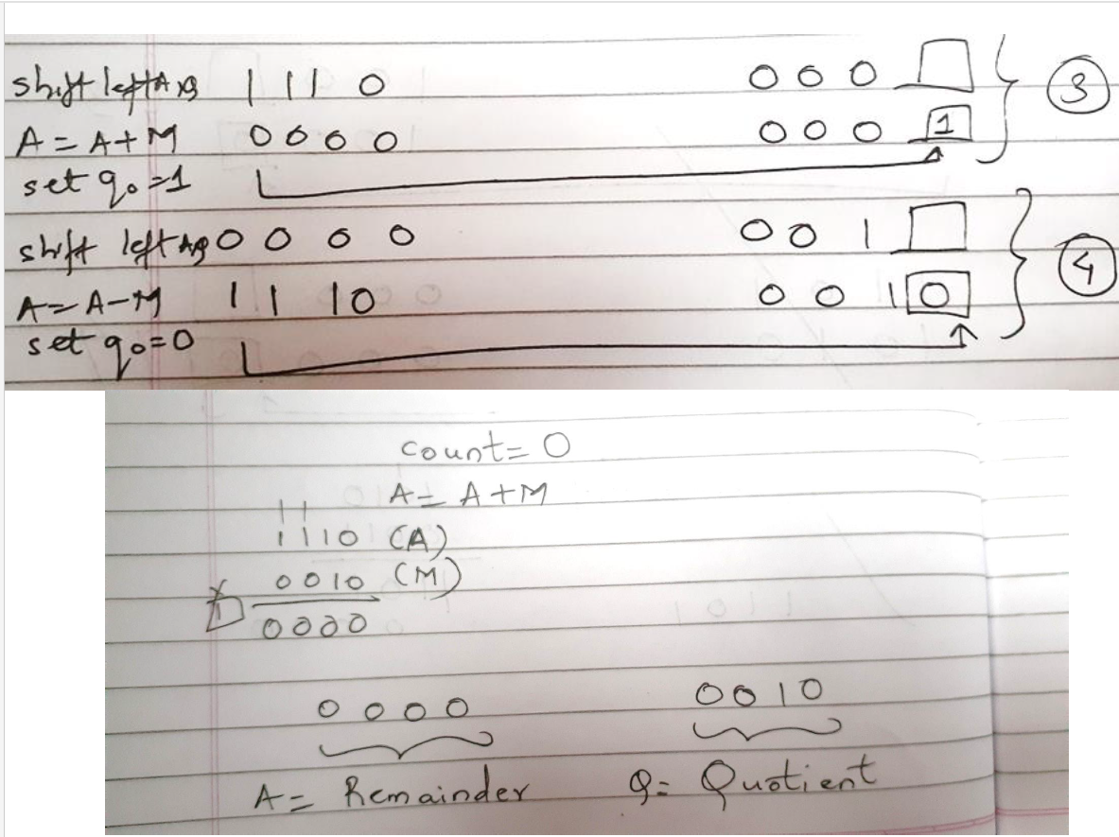

Slide 46
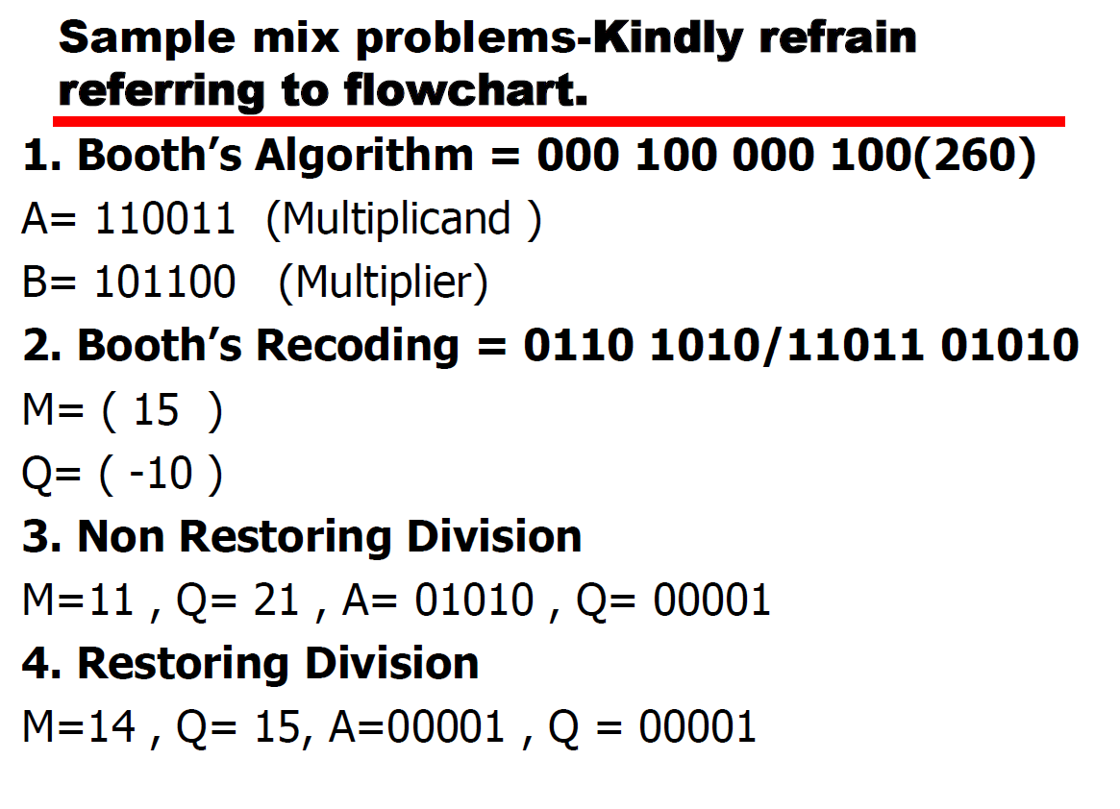

Slide 47
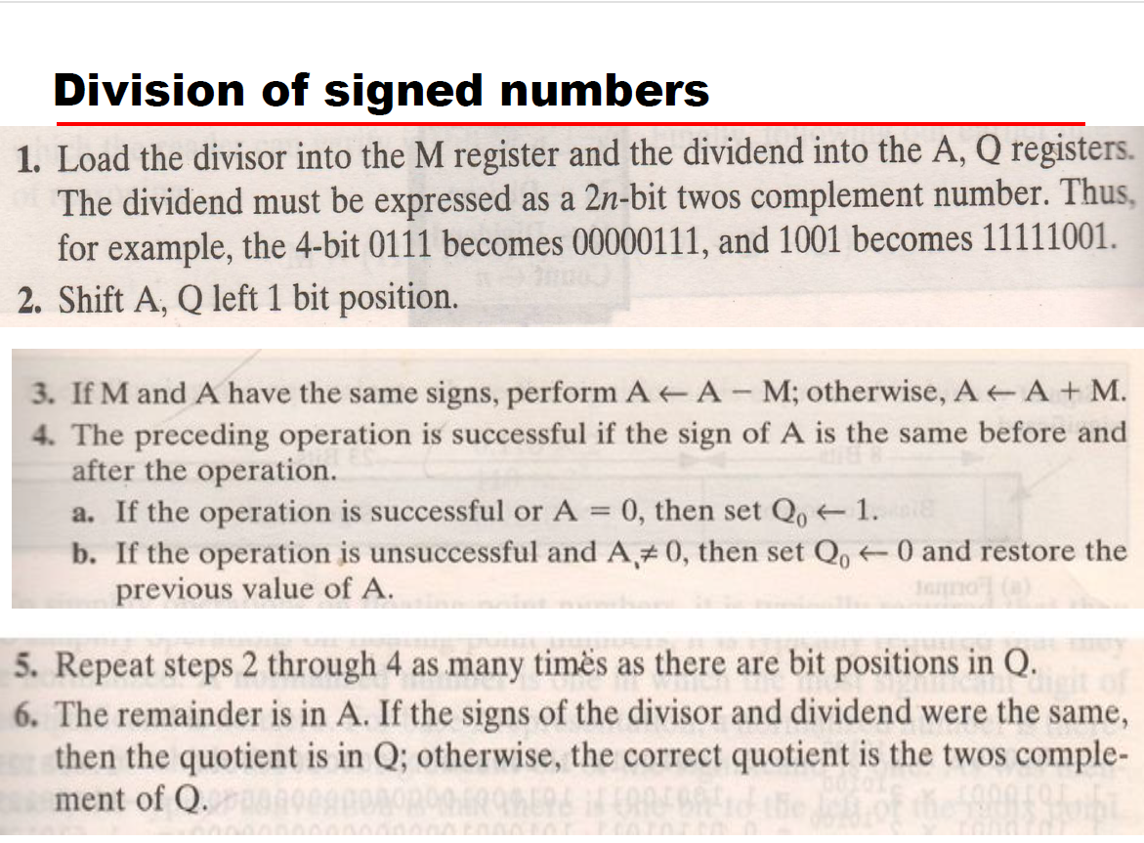

Slide 48
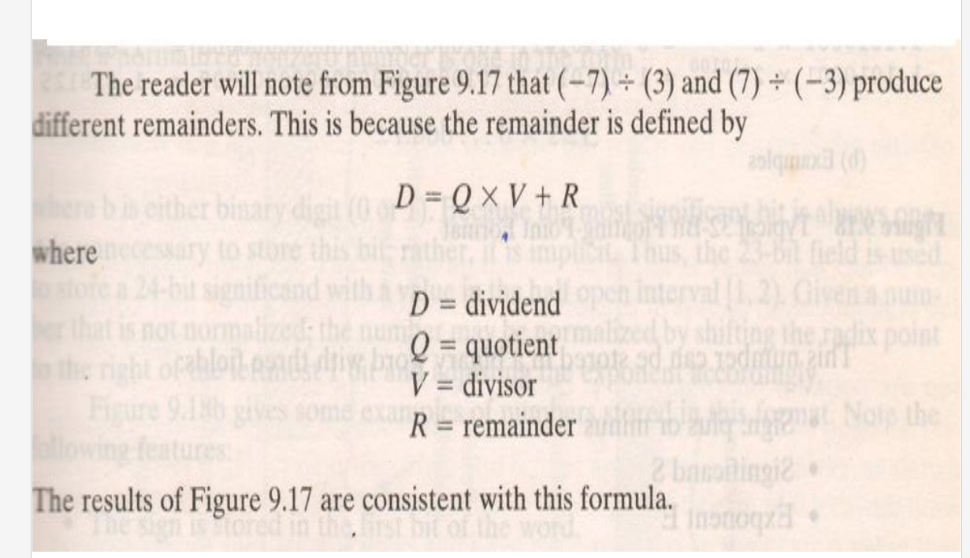

Slide 49
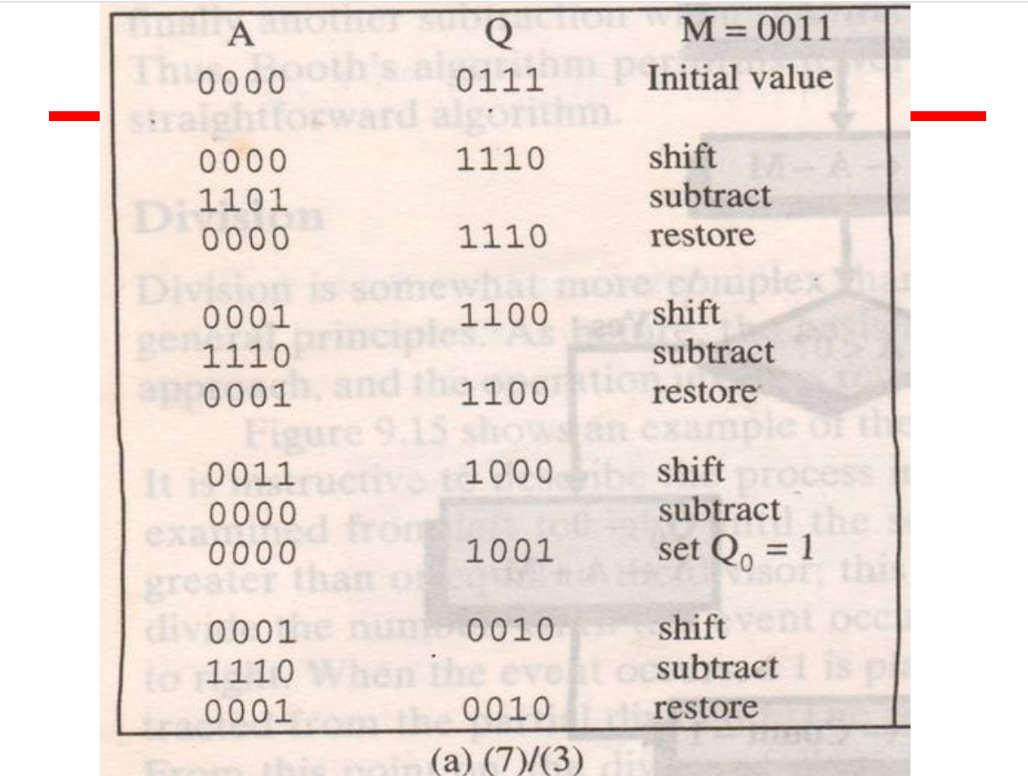

Slide 50
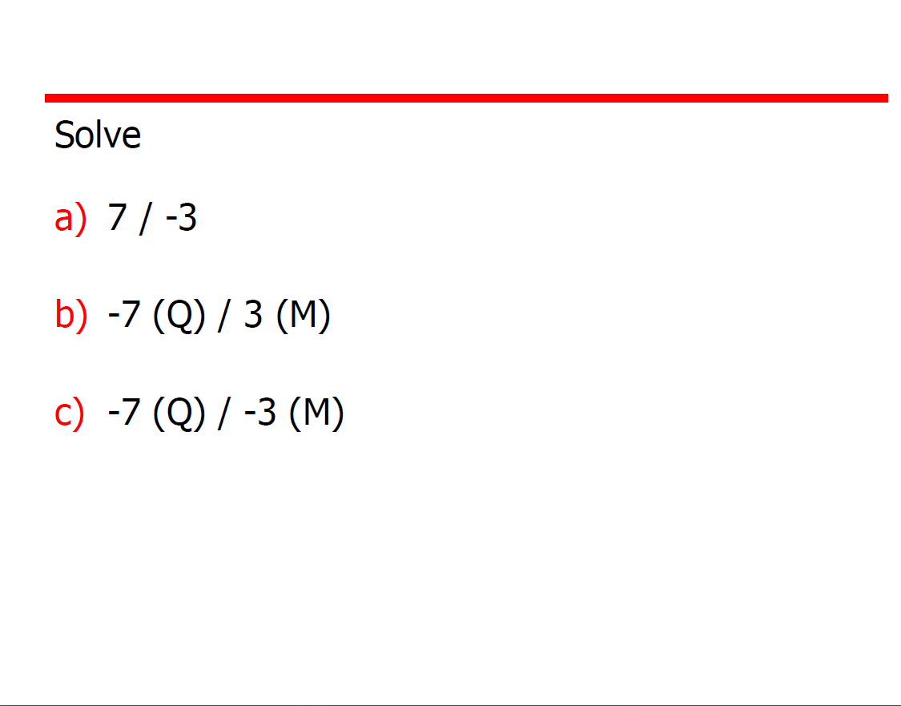

Slide 51
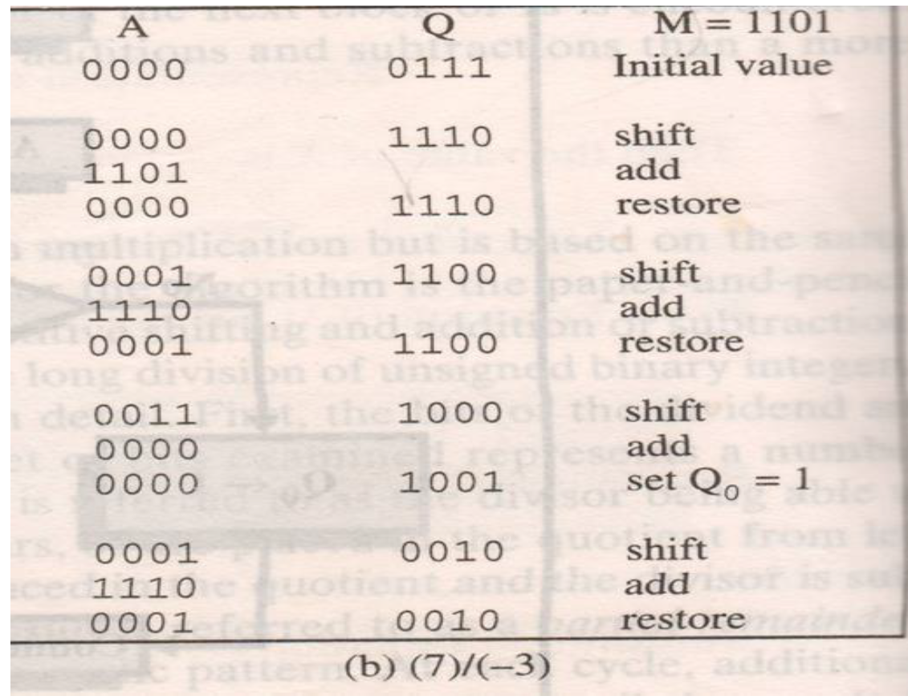

Slide 52
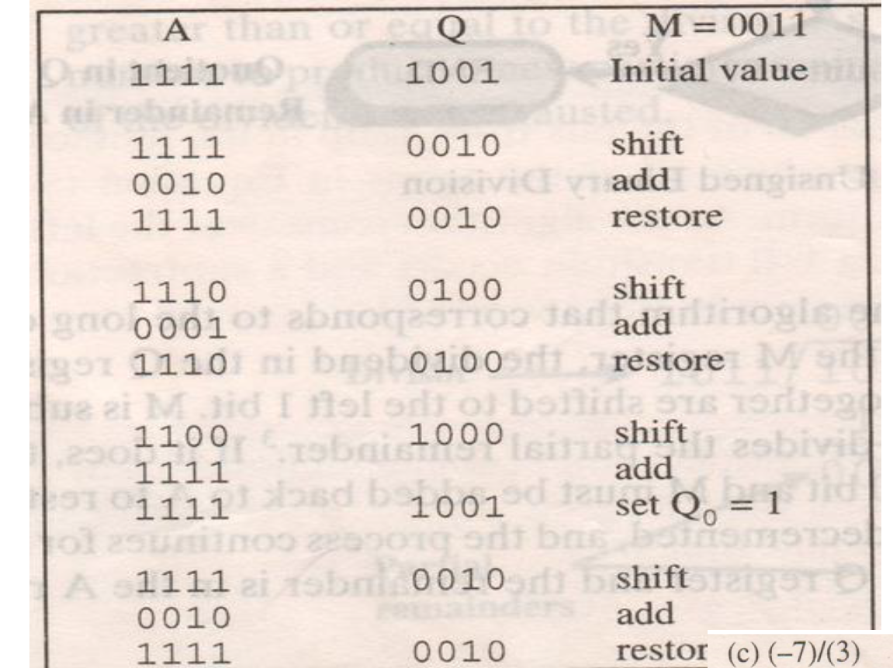

Slide 53
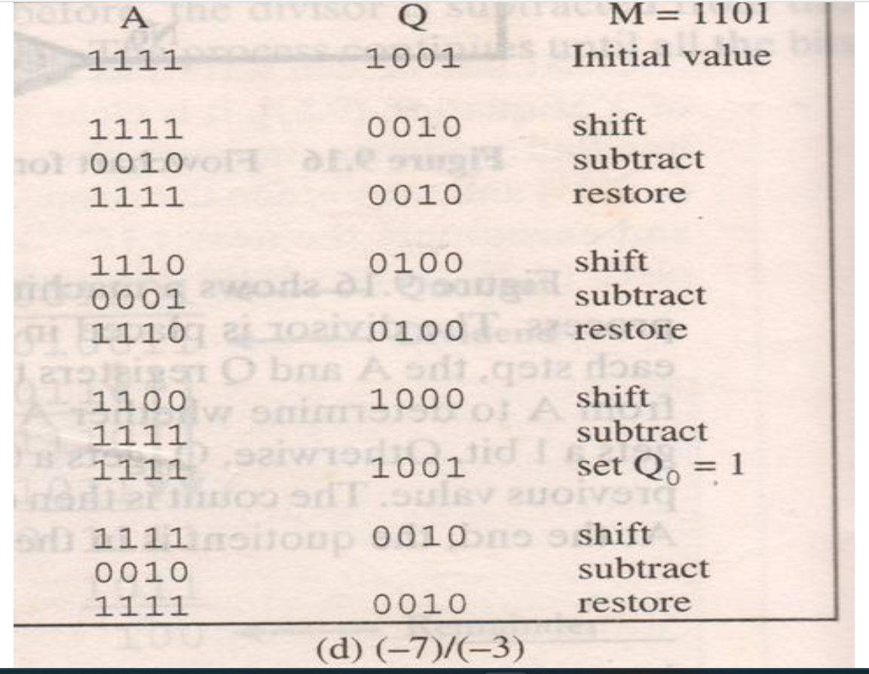

Slide 54
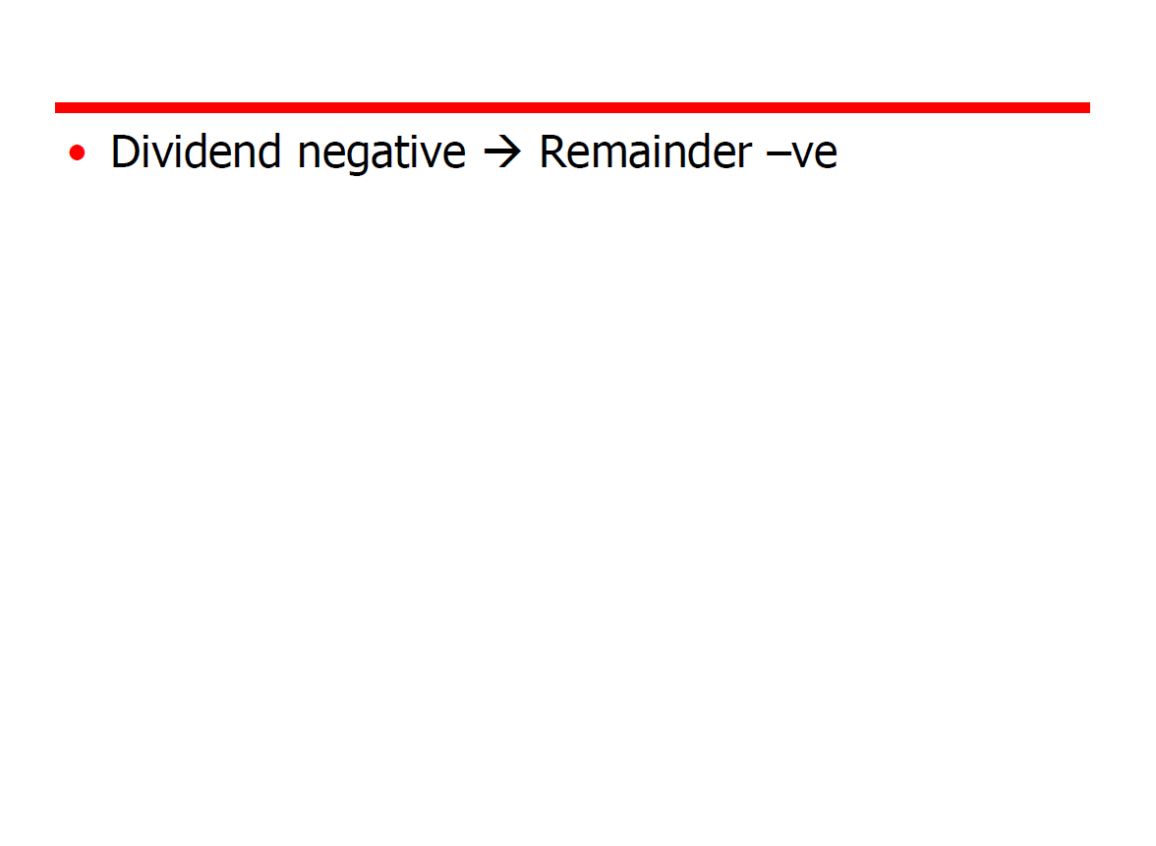

Slide 55
Floating Point representation(IEEE)

Slide 56
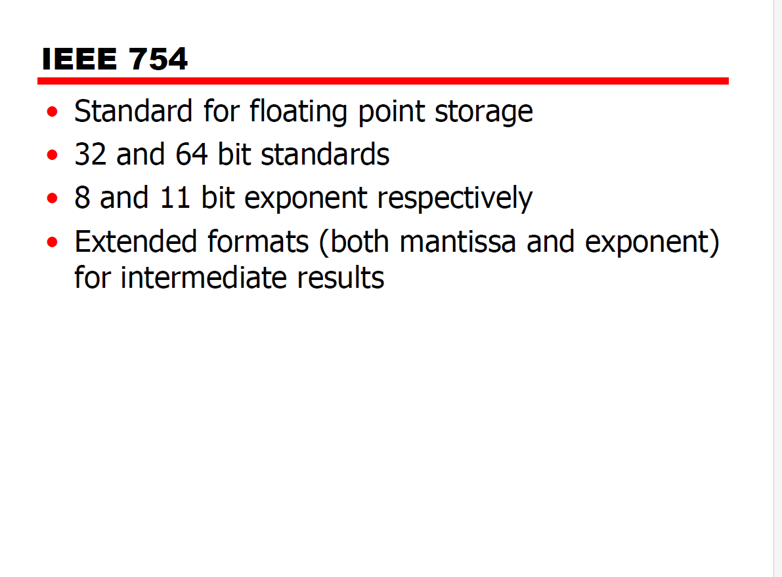

Slide 57
Floating Point Representation
To convert the floating point into decimal, we have 3 elements in an IEEE(32& 64-bit ) floating point representation: i) Sign ii) Exponent iii) Mantissa

Slide 58
IEEE-754-Floating Point Representation
Sign bit is the first bit of the binary representation. ‘1’ implies negative number and ‘0’ implies positive number.
Example: 11000001110100000000000000000000 This is negative number.

Slide 59
Floating Point Representation
To simplify the operations on floating point numbers , they need to be normalized.
A normalized number is one in which the MSB of the significand is one.
The first bit of the significand is made a 1 by normalization and is not stored in the significand or mantissa of(23 bits).

Slide 60
Floating Point Representation
Exponent is decided by the next 8 bits of binary representation. 127 is the unique number for 32 bit floating point representation.
It is known as bias.
It is determined by 2^{k-1} -1 where ‘k’ is the number of bits in exponent field.

Slide 61
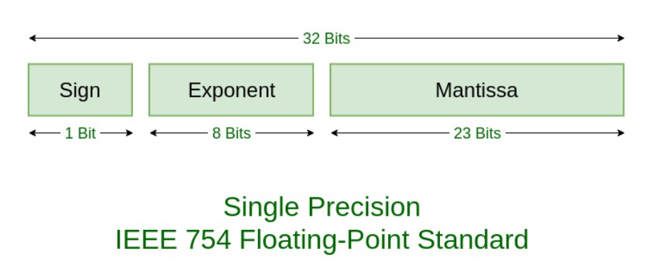
Floating Point Representation
Next - significand or mantissa is 23 bits.
32-bits representation is also called single precision.

Slide 62
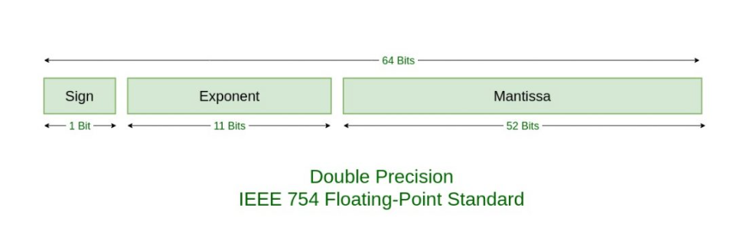
IEEE-754-64 Bit

Slide 63
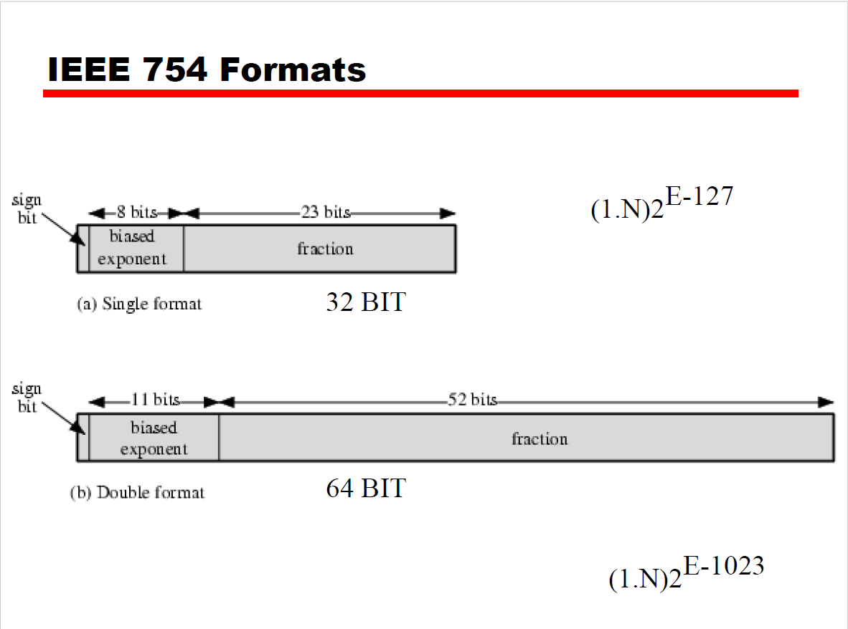

Slide 64
Overflow & Underflow
Errors in floating point numbers-Exceptions.
Overflow-Overflow occurs when an arithmetic operation results in a magnitude greater than an exponent of 128.
Underflow occurs when fractional magnitude is too small.

Slide 65
NAN & De-Normalized Number
An exponent of zero together with a non-zero fraction represents a DE normalized number.
An exponent of all ones together with a non-zero fraction is called NAN.
NAN-Not a Number.

Slide 66
ZERO & INFINITY
An exponent of zero together with a fraction of zero represents positive or negative zero depending on the sign bit.
An exponent of all ones together with a fraction of zero represents positive or negative infinity depending on sign bit.

Slide 67
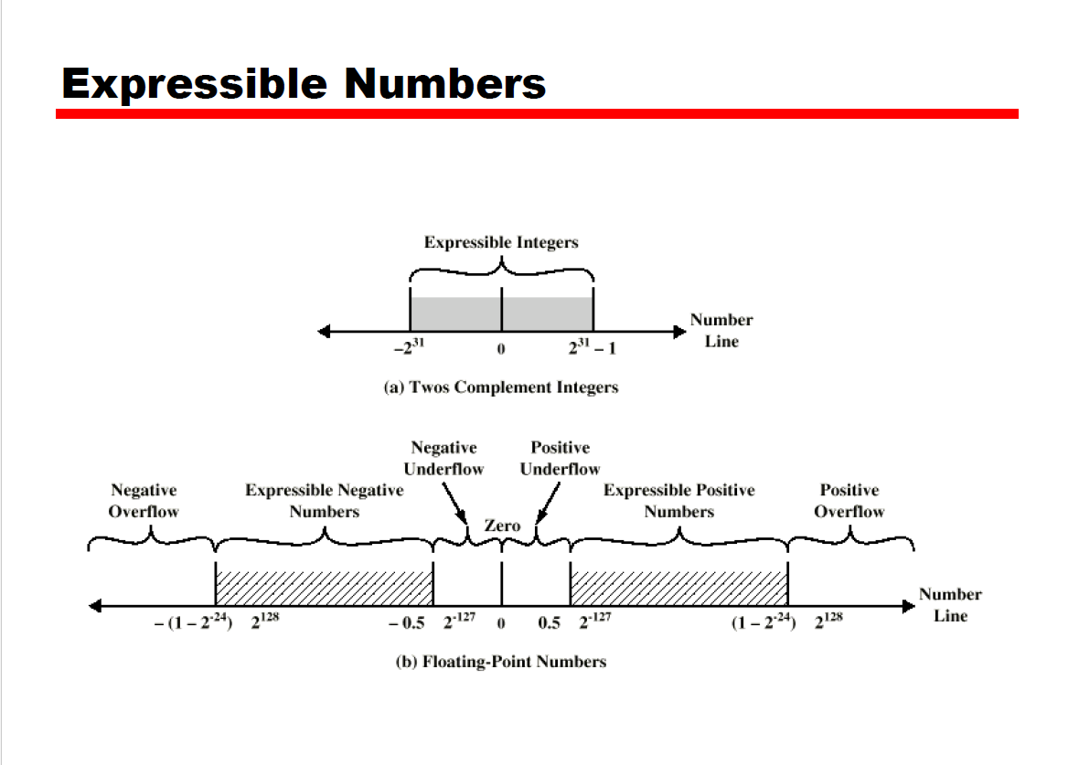

Slide 68
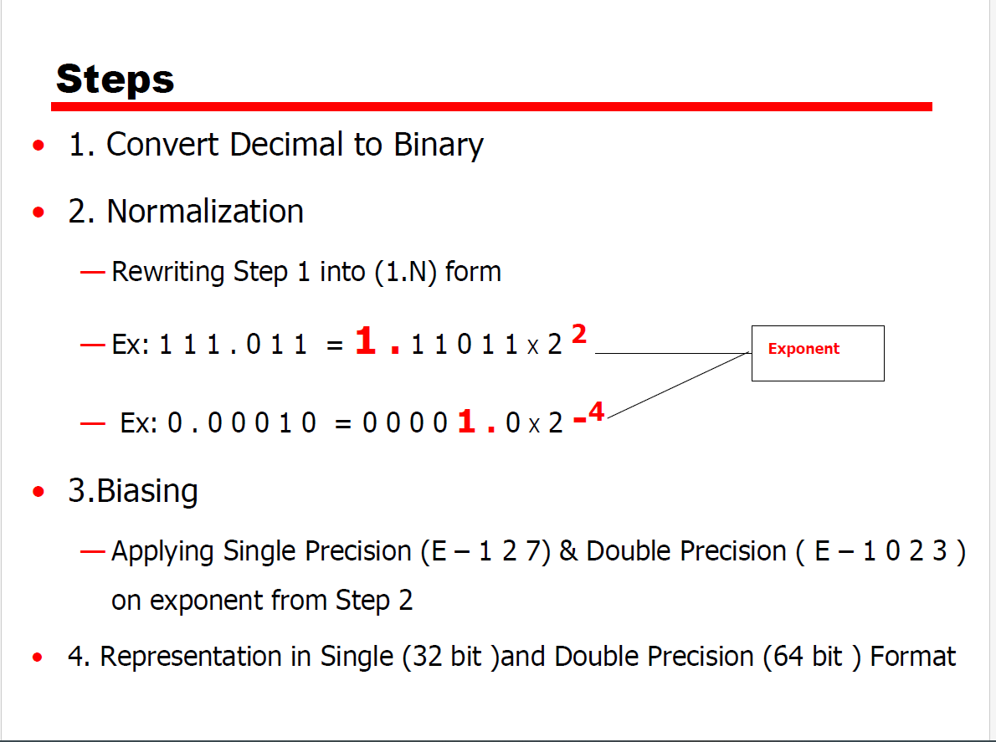

Slide 69
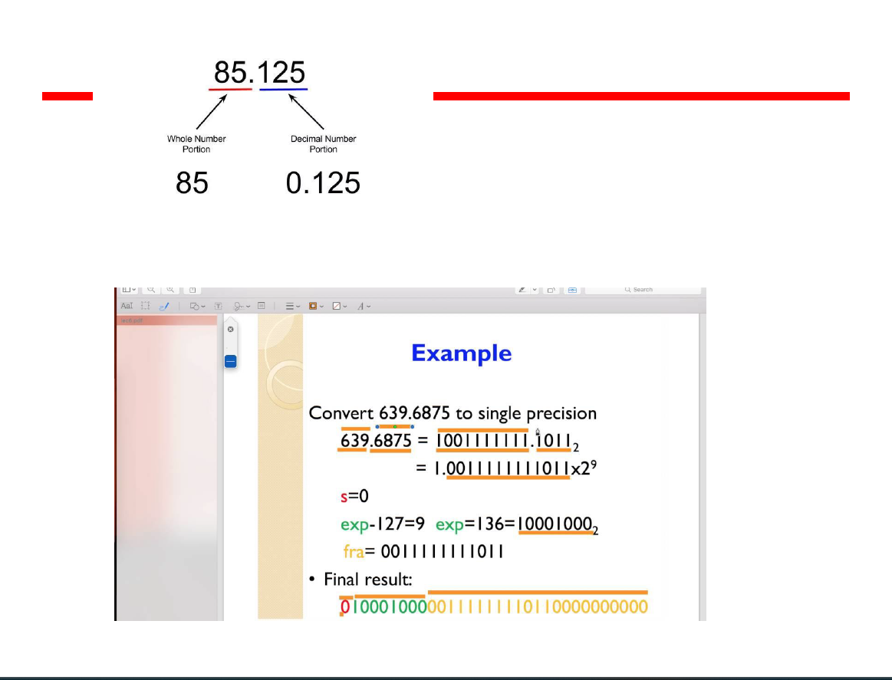

Slide 70
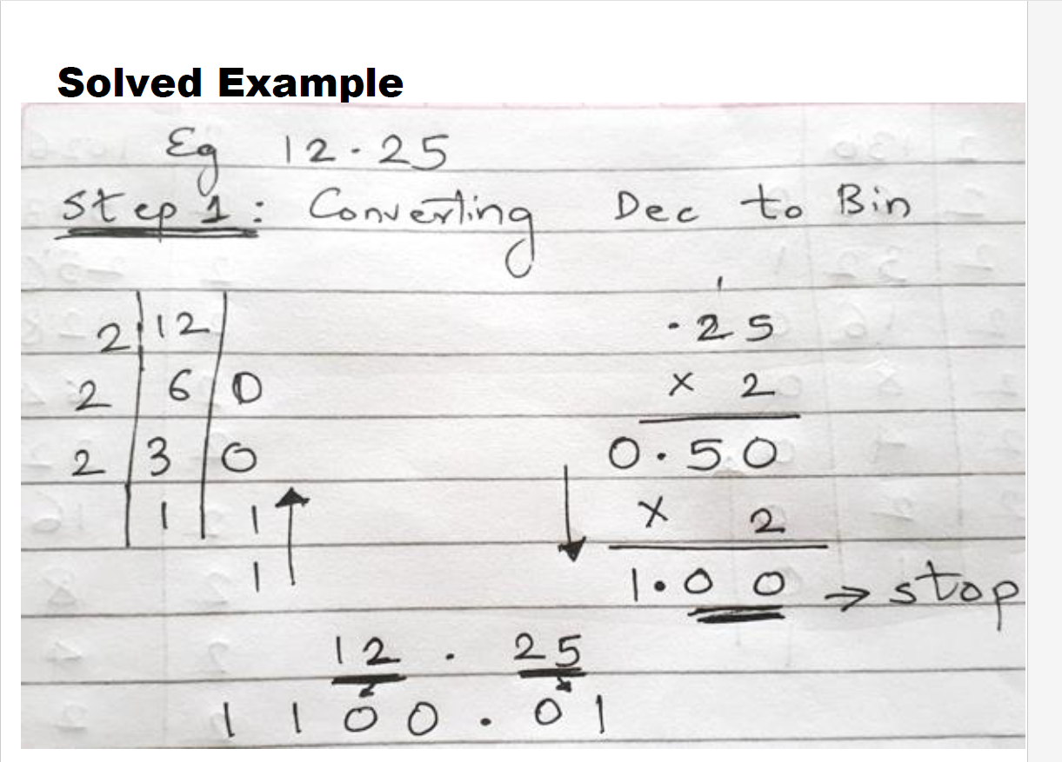

Slide 71
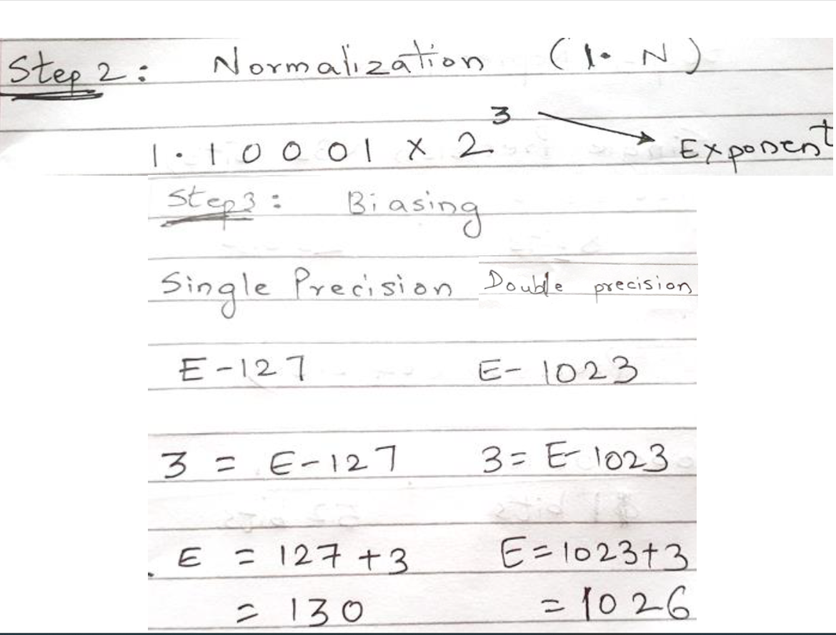

Slide 72


Slide 73


Slide 74


Slide 75


Slide 76

Floating Point Arithmetic

Slide 77


Slide 78


Slide 79


Slide 80


Slide 81


Slide 82


Slide 83


Slide 84


